Slide 1
Serving Government Modernization Project
N&C Walkthrough Meeting

Slide 2
N&C Discussion Topics
Topic 1: What goes where
Topic 2: What changes in News Section
Topic 3: What goes in the Authenticated News section

Slide 3
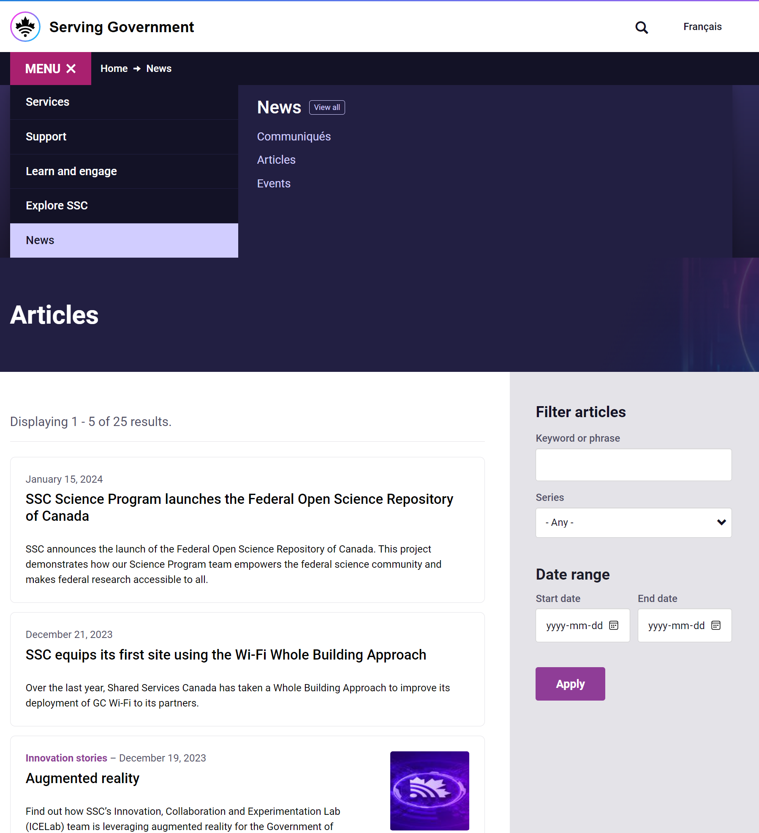
Confirmation
For now, we have planned to continue to use the term “Communique” here and use the term “Communication” in the organization dashboard.

Slide 4
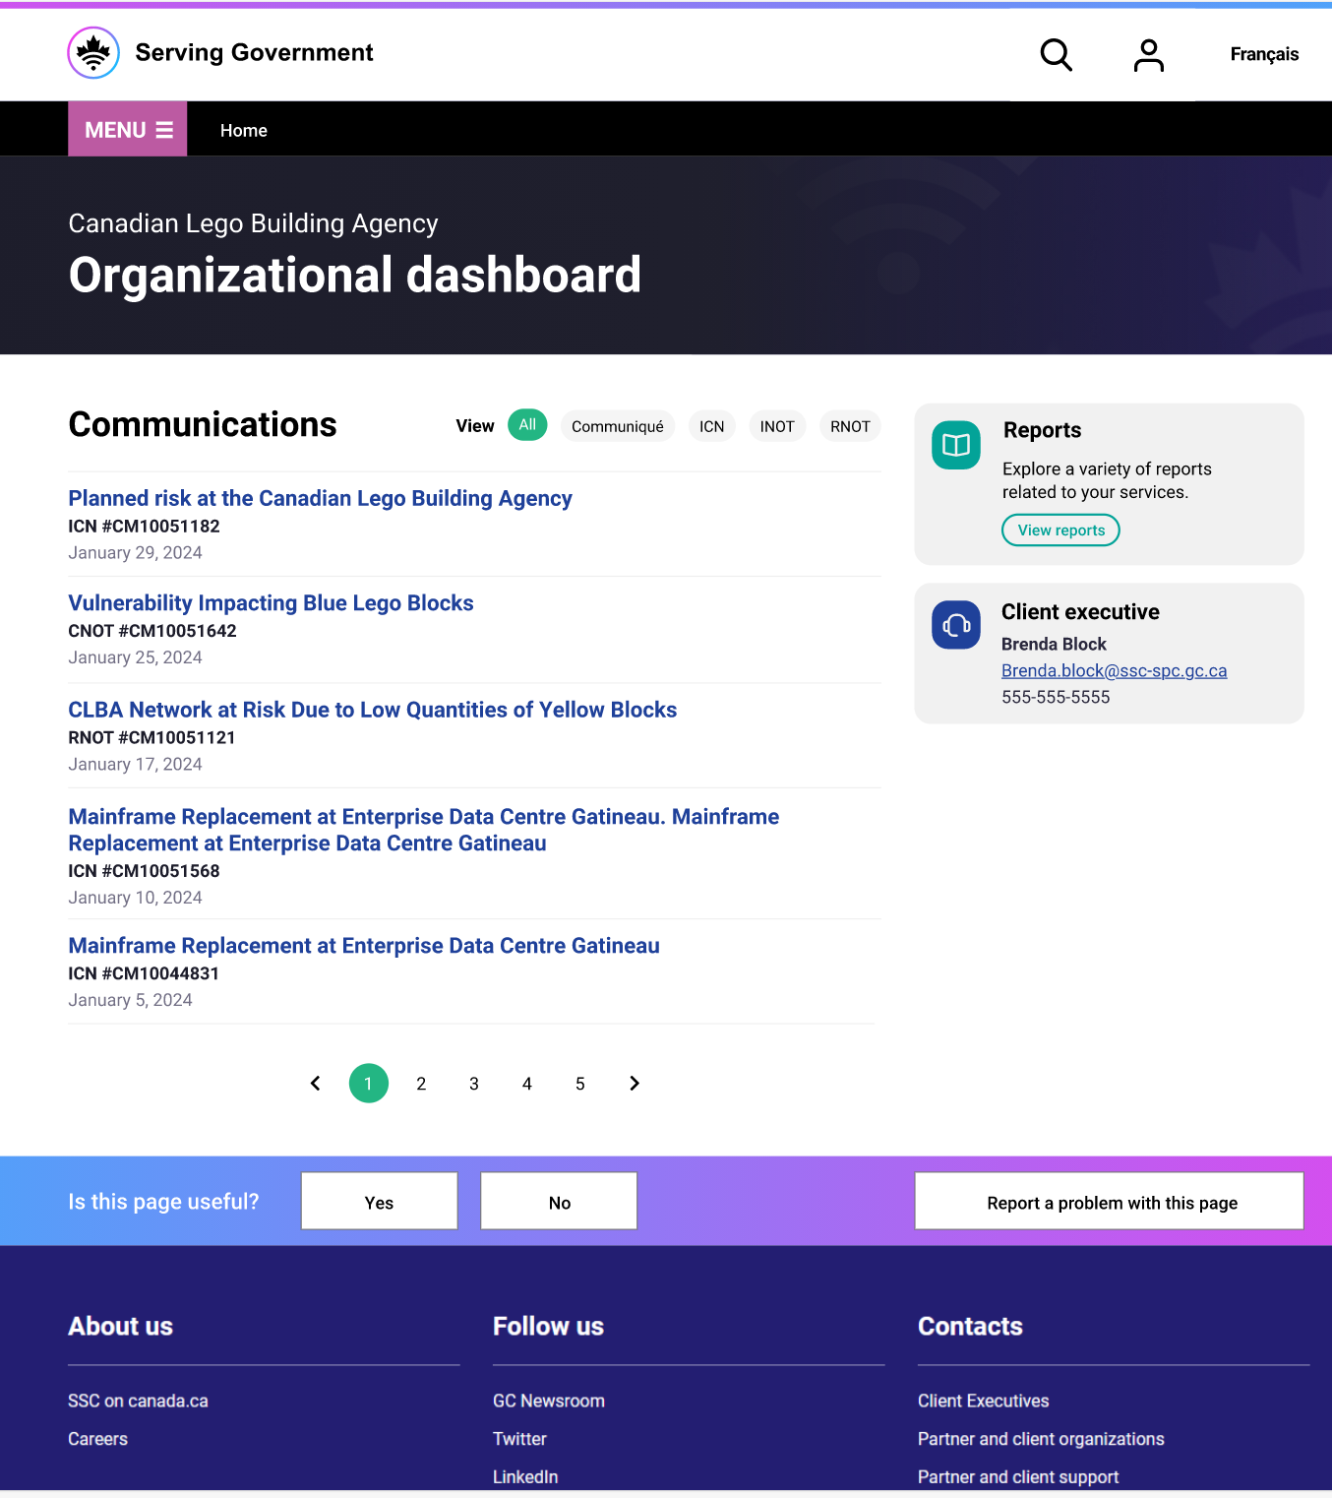
Topic 1: What goes where
Existing News Section has:
SSC Gateway
CIO Communique
Events
New site will have
Risk Notifications (RNOT)
Incident Notifications (INOT)
Forward change Schedule (FCS)
Infrastructure Change Notices (ICNs)
Filtered CIO Communiques
Any questions or concerns with this approach?

Slide 5
Topic 1: Filtered CIO Communiques
Anonymous side
Authenticated side
Currently anyone can view any CIO Communique
Only Filtering is done by a disclaimer stating if it is intended for partners or clients
Authenticated side pulls CIO Communiques from Anonymous side
Displays only the relevant CIO Communiques to that organization
Are CIO communique targeted or will they become targeted? If not, what’s the mechanism for filtering?

Slide 6
Topic 2: What changes in News Section
So far, we assumed when the user is logged in and navigates to the communiques there will be no additional features added (so it is like accessing it anonymously).
Does this make sense?

Slide 7
Topic 3: What goes in the Authenticated News section
BR# | Description
TC1 | Platform will need to support the ability to publish to organizational users the following information that are targeted to their organization: Infrastructure Change Notice (ICN) – refer to appendix for more information about ICN. Risk Notification (RNOT) – refer to appendix for more information about RNOT. Incident Notification (INOT) – refer to appendix for more information about INOT.
TC2 | Ability for ICNs, RNOTs, INOTs to be published by the appropriate team with up to date templates.
TC3 | Ability for ICNs, RNOTs, and INOTs to be assigned by the appropriate team to the affected organization(s)
TC4 | Ability for platform to pull CIO Communiques from Anonymous side and filter, based CIO Communiques that have been associated to an organization
TC5 | Ability for Client Organization’s users to access, consult, and filter by type ICN, RNOT, INOT, and CIO Communique through their Organization page.
TC6 | Ability for platform to send ICN, RNOT and INOT notifications by email, containing a link to the communications section of the Organizational page.
TC7 | Ability for the platform to display notifications for all Targeted Communications

Slide 8
ICNs
Three Options for the Way Forward
Within MVP and Current Comms Mechanisms
Within MVP and new Comms Mechanisms
Future releases and Current Comms Mechanisms
Authorized Users, Chosen by external organization based on current ICN distribution lists
Who all falls into CIO+?
If we limit authorized users to CIO+ who are we leaving out?
Authorized Users based on previous validation sessions
ICNs potentially reaching new audiences
What are the security implications of this?
If the external organization is comfortable with this are we?
Authorize whoever the organization wants
Limit ICNs and other communications to whoever needs to see them
Descopes a portion of MVP that would be easy to include from a technical standpoint

Slide 9
Background on All N&C Types in Business Case
SG1 (Implemented already)
Type | About Process | Sample | May target specific partners
SSC Gateway | Link to doc | Link | No
CIO Communique | Link to doc | Link | Yes
Service Line Messages | Link to doc | Link | Filtered not targeted
SG2
Type | About Process | Sample | May target specific partners | Current Comms Mechanism
Risk Notifications (RNOT) | Link to doc | Initial Resolution | Yes | Email to the SSC Distribution list. The affected departments are added by adding (SPOC) in the CC field
Incident Notifications (INOT) | Link to doc | Link Merged INOT | Yes | Email to the SSC Distribution list. The affected departments are added by adding (SPOC) in the CC field
Forward Schedule Changes (FSC) | Link to doc | Link | Yes | Generated by Onyx, Emailed to a Client Maintained Distribution listed. Can be accessed in ONYX
Infrastructure Change Notices (ICNs) | Link to doc | Link | Yes | Email to CIO+ of affected department. Average of 5 people, varies by department
Cyber Incidents (CNOT) | Link to doc | Link | Yes | Email

Slide 10
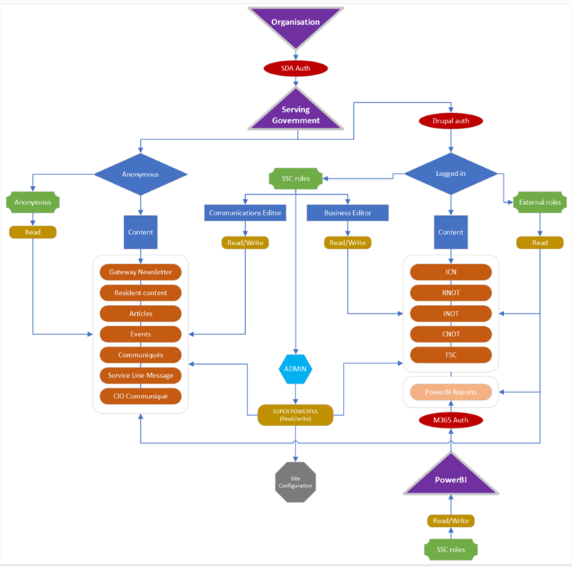

Slide 11
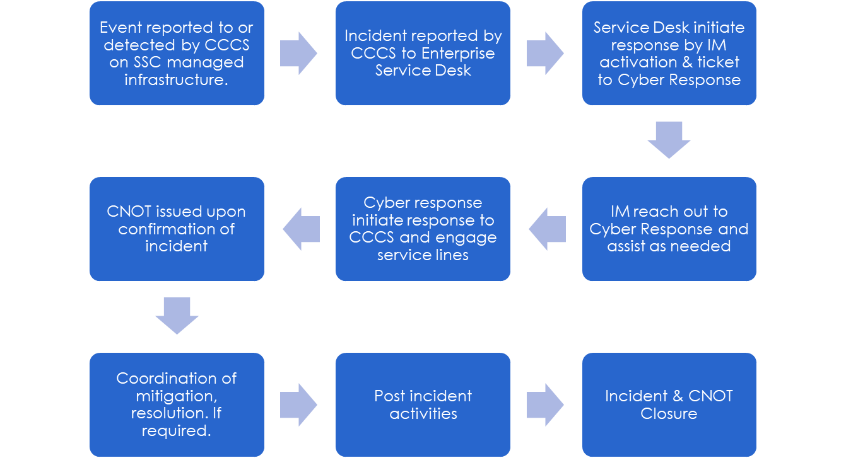
Important Considerations
Protected B
Email sent to SPOC of affected department and SSC Distribution list
If there is Service Disruption, SSC Provides affected Departments with INOT
If there is no Service Disruption. CNOTs sent to SSC distribution list
Partners do not receive CNOTS from everything I have read. Instead, the Partner is notified through the involvement of the event/incident
Notes:
Speaking point at the start: GCCSEMP classifies cyber incidents as Level 1 through 4, with 4 being the highest criticality. Here we show a Level 1, where usually only one partner is involved.
Only Client Exec impacted receive the notification. It would be all if GoC impact.-From Presentation but The word document says it is sent to a distribution list. There is little mention of GC
Public and GC communication
•TBS CIO communique
•
•TBS news release
•
•CCCS publications
•
•ECT / EMT involvement through GC-CSEMP level 2 or higher

Slide 12
Roles Required
Role | Description of Permissions
Risk Notifications Team | Access to edit content related to RNOTS.
Change Management Team | Access to edit content related to FSCs and ICNs
Infrastructure Notifications Team | Access to edit content related to INOTs.
Communications | Access to edit content with the following exclusions / exceptions: 1.Content under the purview of the Risk Notification Team 2.Content under the purview of the Change Management Team 3.Content under the purview of the Infrastructure Notification Team 4.Content under the purview of the Organizational user management 5.Content under the purview of the Organization Management
Editor (built-in role) | Referred to in this document as the application administration role. In other words, members of that team supporting the application will be enrolled directly into the “Editor” role.
Administrator (built-in role) | This role should be exclusive to the team supporting the platform.
Will each team have their own view where they can view all their respective communication types ?

